Slide 1
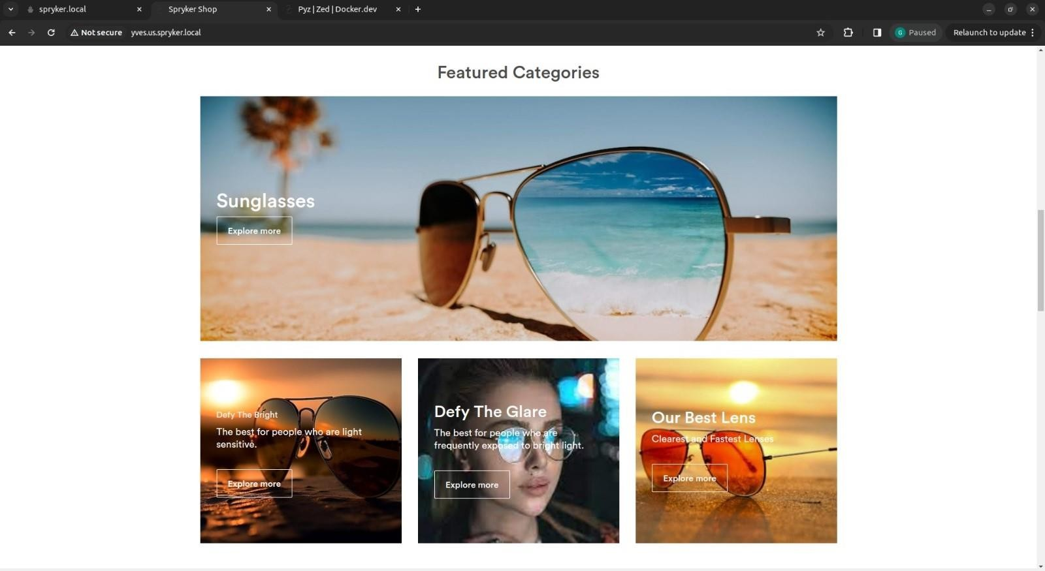
Transition Lenses Store
Using SCCOS
Submitted By:
Archi Pamecha(20ETCCS009)
Arnav Tyagi(20ETCCS011)
Devesh Mali(20ETCCS030)
Gaurav Jain(20ETCCS041)
Muskan Choudhary(20ETCCS076)

Slide 2
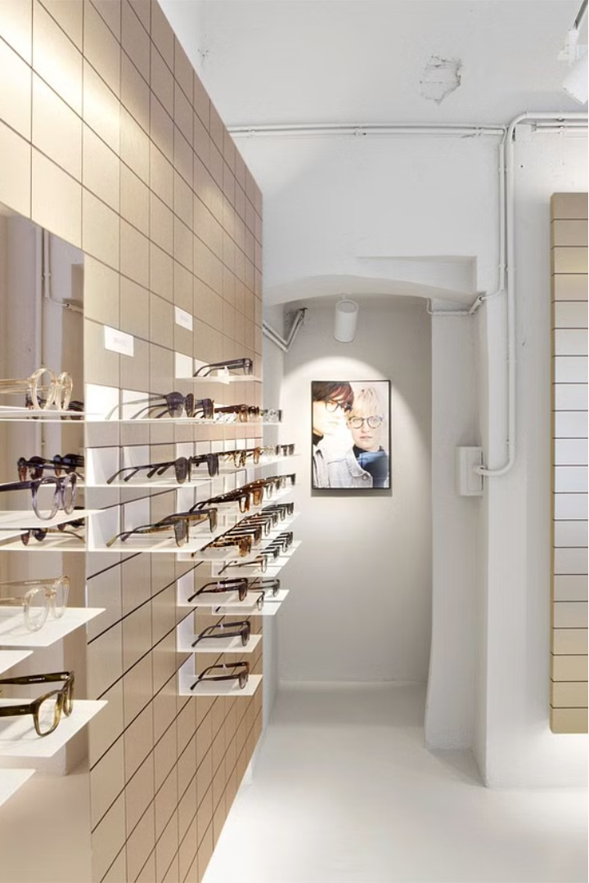
Transitions Lens Store: Revolutionizing the Eyewear Experience
Welcome to the Transitions Lens Store, where we are dedicated to providing our customers with a seamless and innovative e-commerce platform for all their eyewear needs. Leveraging the power of the Spryker Cloud Commerce Operating System (SCCOS), we have created a robust and modular solution that streamlines product management, order processing, and customer engagement. Our goal is to deliver a truly exceptional shopping experience that caters to the diverse requirements of both B2B and B2C clients.

Slide 3
Spryker Commerce OS: The Backbone of Our Success
1
Modular Architecture
2
Layered Approach
The Spryker Commerce OS is built on a modular architecture, comprising over 750 individual modules. This allows us to easily integrate new features and functionalities, ensuring that our platform remains agile and adaptable to the evolving needs of our customers.
By separating our commercial offering from the sales channels, the layered architecture of SCOS enables us to seamlessly expand into new markets and touchpoints, without compromising the core of our business.
3
Reduced TCO
The modular design and API-driven integration of SCOS significantly reduce our total cost of ownership, allowing us to focus on delivering exceptional value to our customers while maximizing our return on investment.

Slide 4
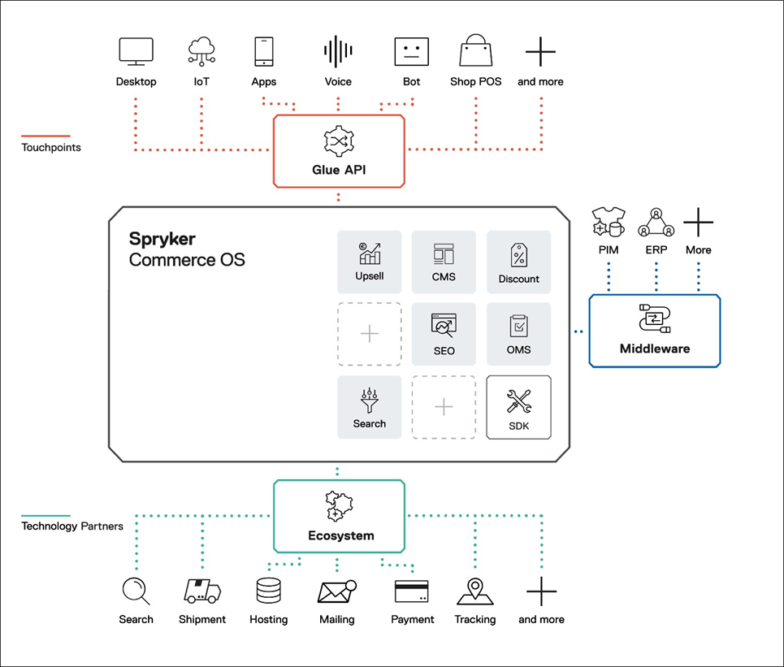
Spryker Commerce OS

Slide 5
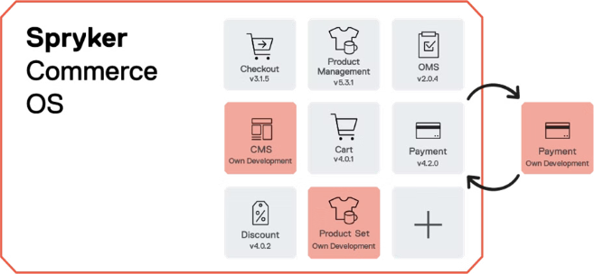
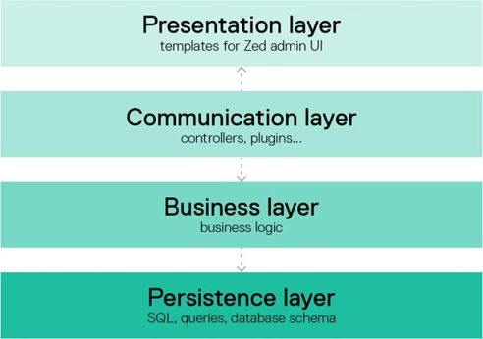
Modular Architecture of Spryker Commerce OS
Layered Architecture of Spryker Commerce OS

Slide 6
B2B Marketplace: The Showcase of Our Capabilities
Back Office
Storefront
Continuous Innovation
Our robust Back Office interface empowers our administrators to effectively manage customers, products, shop navigation, content, orders, and returns, ensuring a seamless and efficient operation.
The Storefront, our customer-facing web shop, allows users to browse through our extensive product catalog, add items to their cart, and complete their purchases with ease.
We regularly update our B2B Marketplace with new features and functionalities, ensuring that our platform remains at the forefront of the industry and continues to meet the evolving needs of our customers.

Slide 7
Packaged Business Capabilities: The Building Blocks of Our Success
User Management
Product Information Management
Our comprehensive User Management PBC allows us to effectively manage user accounts, permissions, and access controls, ensuring the security and integrity of our platform.
The Product Information Management PBC empowers us to create, update, and maintain detailed product data, enabling our customers to make informed purchasing decisions.
Order Management
Discount Management
The Order Management PBC streamlines the order fulfillment process, allowing us to track orders, process returns, and provide our customers with a seamless post-purchase experience.
The Discount Management PBC enables us to create and apply various discounts and promotions, helping us to attract and retain customers while maintaining profitability.

Slide 8
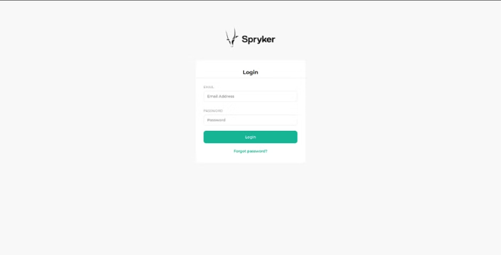
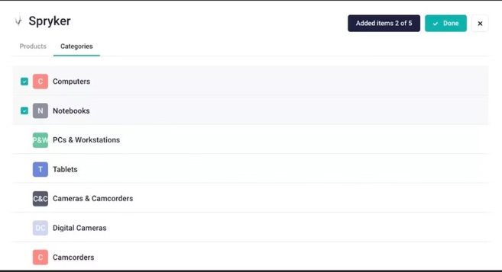
User Management PBC (User Authentication)
Product Management using Categories in PBC

Slide 9
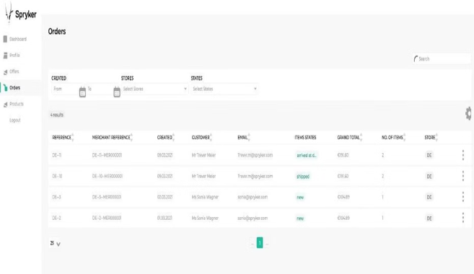
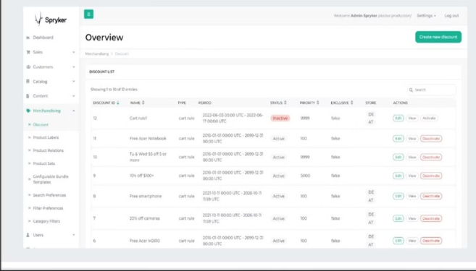
Managing orders in B2B marketplace
Discount Managing in B2B Marketplace

Slide 10
Transitions Lens Store: Redefining the Eyewear Experience
1
Comprehensive Product Catalog
2
Seamless Order Management
Our Transitions Lens Store offers an extensive product catalog, featuring a wide range of eyewear and lens options from top brands, catering to the diverse needs and preferences of our customers.
Leveraging the power of SCOS, we have streamlined the order management process, allowing customers to easily add items to their cart, apply discounts, and choose from multiple payment options, including card, UPI, net banking, and cash on delivery.
3
Secure User Experience
4
Transparent Invoicing
To ensure the security of our customers' accounts, we have implemented a robust login system, requiring users to authenticate with their credentials before accessing their account information and placing orders.
Our platform generates detailed invoices for each order, providing our customers with a clear record of their purchases and facilitating seamless record-keeping and accounting processes.

Slide 11




Enhancing the Customer Experience
Intuitive Search
Advanced Filtering
Customer Reviews
Dedicated Support
Our platform offers an intuitive search functionality, allowing customers to easily navigate our product catalog and find the perfect eyewear solutions to meet their needs.
Customers can refine their search results using our advanced filtering options, such as brand, lens type, and price range, ensuring they can quickly and efficiently find the products they're looking for.
Our platform encourages customers to share their feedback and experiences, providing valuable insights that help us continuously improve our offerings and better serve our clients.
Our team of knowledgeable and responsive customer support representatives are always available to assist our clients with any questions or concerns they may have, ensuring a seamless and satisfactory experience.

Slide 12
Streamlining Operations with SCOS
Product Management
Order Processing
Customer Engagement
The modular and layered architecture of SCOS enables us to efficiently manage our product catalog, including adding new products, updating existing ones, and maintaining accurate inventory levels.
SCOS streamlines the order management process, allowing us to quickly and accurately process customer orders, handle returns, and generate detailed invoices.
Our platform's user-friendly interface and robust features, such as advanced search and filtering, enable us to provide our customers with a seamless and engaging shopping experience.

Slide 13



The Future of Eyewear E-commerce
Augmented Reality
We are exploring the integration of augmented reality technology, which will allow our customers to virtually try on different eyewear options, enhancing their shopping experience and reducing the likelihood of returns.
Personalized Recommendations
By leveraging advanced data analytics and machine learning, we aim to provide our customers with personalized product recommendations, helping them discover the perfect eyewear solutions tailored to their individual needs and preferences.
Voice-Controlled Shopping
As voice-controlled technologies continue to evolve, we are investigating the integration of voice-based interfaces, allowing our customers to seamlessly navigate our platform and complete their purchases using natural language commands.

